Slide 1
.
Heat-machine control by quantum-state preparation
D. Gelbwaser-Klimovsky, R. Alicki & G.K
What is truly quantum about quantum thermodynamics?
Thermodynamic laws and bounds are not well understood for quantum-system manipulations . We challenge:
Carnot efficiency bound of quantum heat engines/refrigerators (Second law)
Unattainability of absolute zero (Third law)
The means:
Control by modulation
Control by state preparation
Control by bath engineering?
Telluride14

Slide 2
Preamble: Measurement/modulation-driven cooling of a qubit in a bath breaks detailed balance
N. Erez et al., Nature 452, 724 (2008); G. Gordon et al., NJP 11, 123 025 (2009)
G. Alvarez, et al. PRL 104 040401 (2010)

Slide 4
M. Kolar, et al. PRL 109 090601 (2012));D. Gelbwaser-Klimovsky, et al. PRE 87, 012140 (2013);
EPL 103 60005 (2013); D. Gelbwaser-Klimovsky, Phys. Rev. A 88, 022112 (2013); arXiv:1309.5716 [quant-ph]

Slide 5
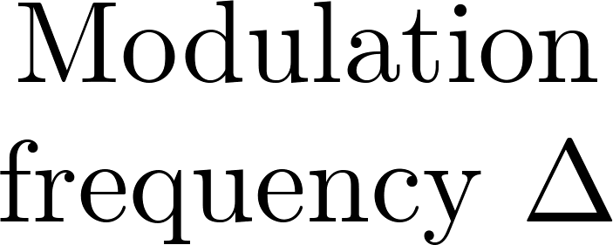
Minimal simplest quantum heat machine
D. Gelbwaser-Klimovsky, R. Alicki, G. Kurizki, Phys. Rev. E 87, 012140 (2013)
Components
Working fluid: (Two-level system TLS).
Hot and cold bath permanently coupled to the system (weak coupling).
A piston (external field) periodically modulates the system (level distance)
extracts/invests work.
Δ
Average over cycle: Markovian
R Alicki 1979 J. Phys. A: Math. Gen. 12 L103,.
Notes:
Hacerla de emocion el permanetely coupled!

Slide 6
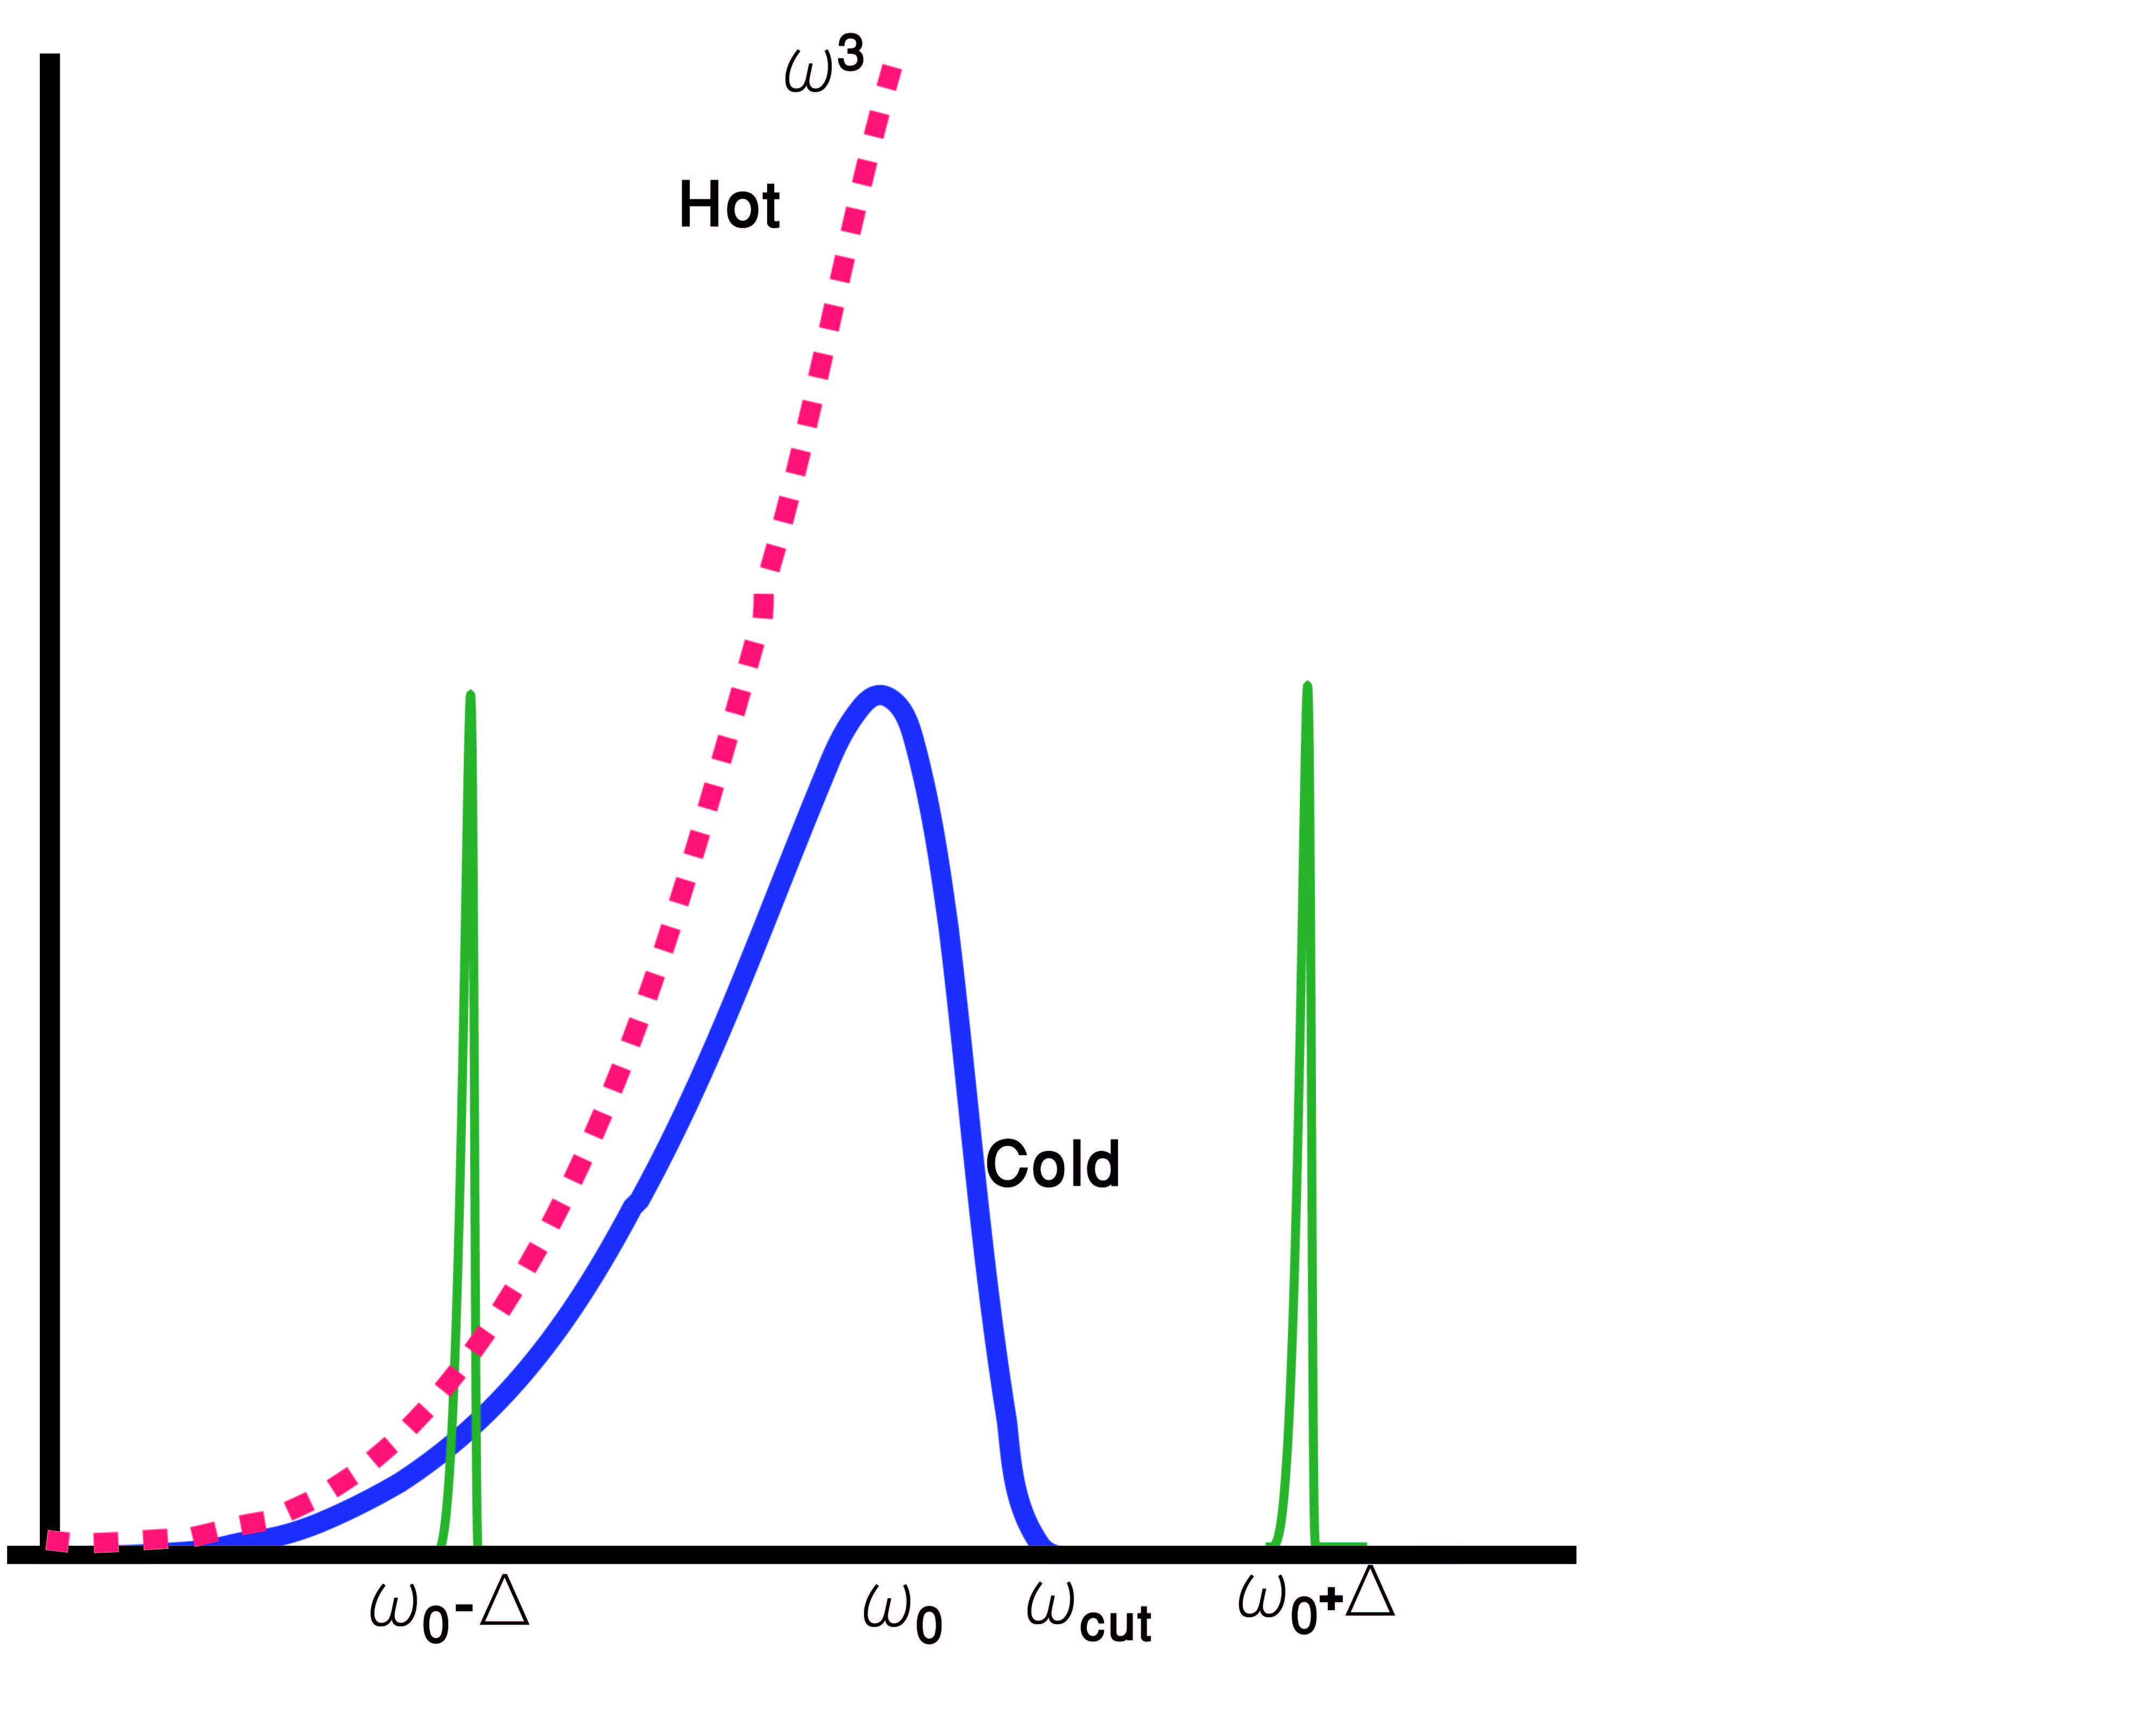
Spectral separation of C&H baths
(M. Kolar, D. Gelbwaser-Klimovsky, R. Alicki & GK PRL 109 090601 (2012))
TLS
Heat pump (QR) condition:
QHE:
Breakdown of detailed balance (non-equilibrium)

Slide 7
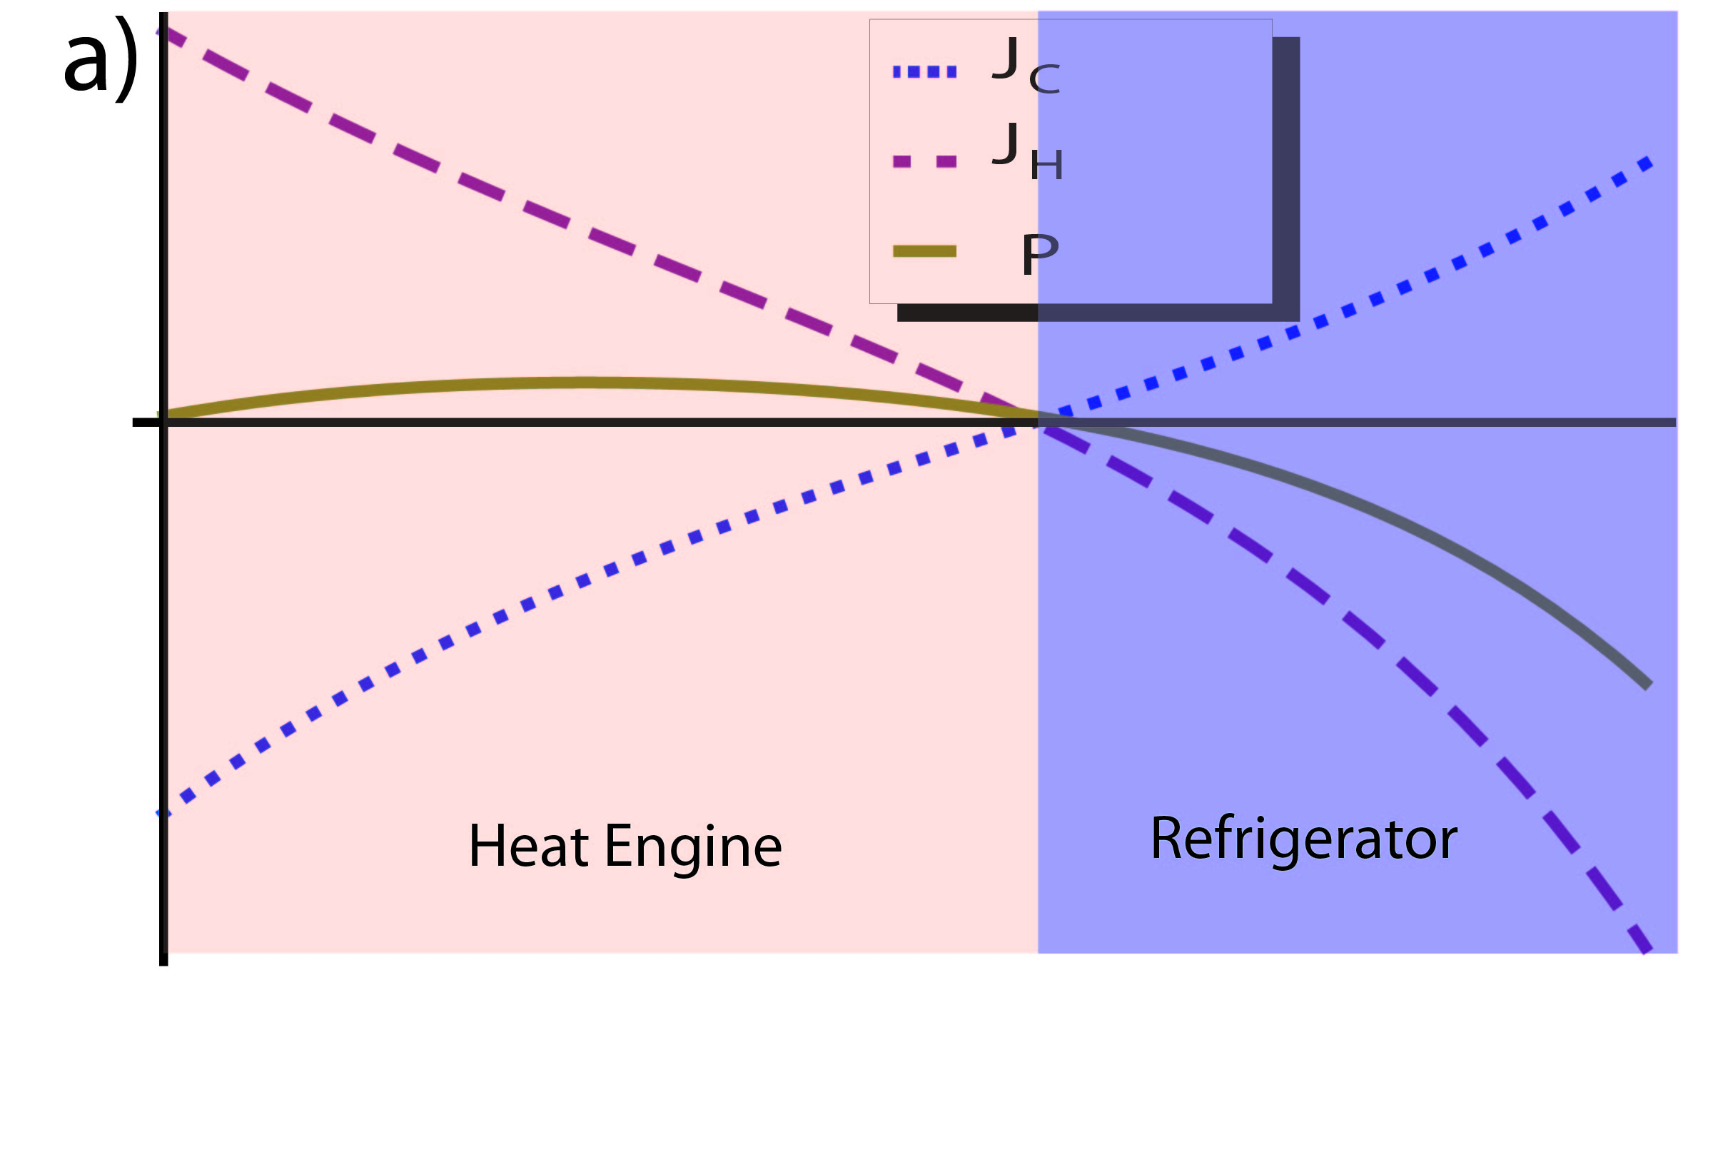
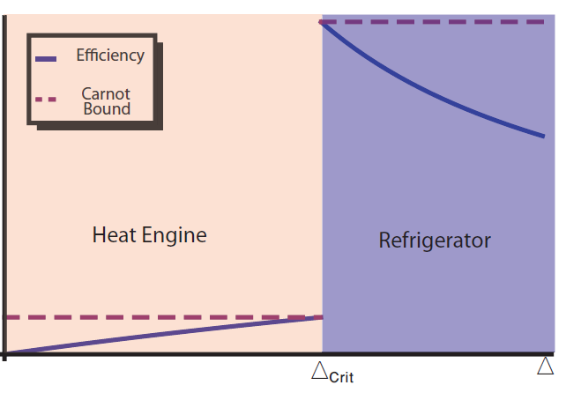
Minimal (Simplest) Quantum Heat Machine (Under Spectral Separation of Baths) D. Gelbwaser-Klimovsky, R. Alicki & G.K., PRE 87, 012140 (2013)
Quantum heat engine (QHE)
Max Power >> Curzon- Ahlborn
Although highly nonadiabatic!
Carnot
bound

Slide 8
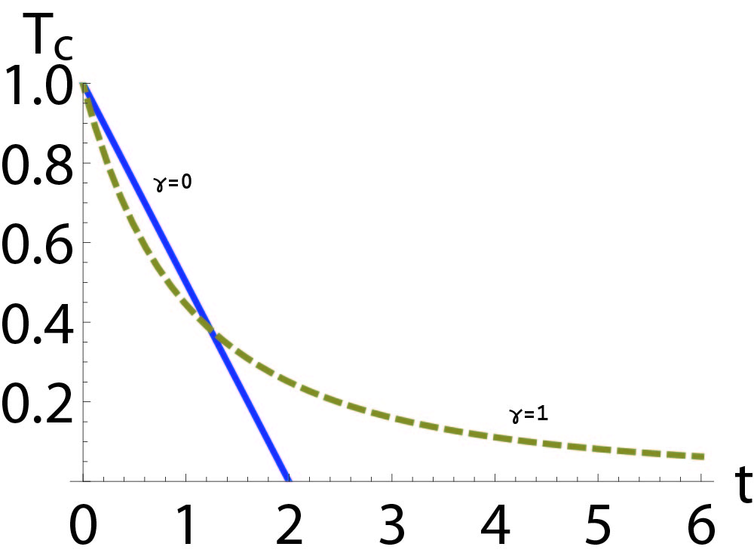
Quantum Bath Refrigeration: Towards Absolute Zero? M. Kolar, D. Gelbwaser-Klimovsky, R. Alicki & G.K. PRL 109, 90601 (2012)
Determined by bath dispersion
i) Acoustic phonons
ii) Magnons (spin-wave)/dipole-coupled atom chain:
(freezing)
Nernst’s 3rd law (unattainability principle) challenged

Slide 9
Energy exchange between quantum systems
Energy
exchange
How is energy exchange divided into work and heat?

Slide 10
I. Work capacity
Higher work capacity
Notes:
Work different from heat
Work capacity

Slide 11
II. Compliance with 1st & 2nd laws of driven/modulated machine
(average over cycles)
First law
Output power
Input heat-flow
Second law
Spohn’s inequality
Steady state
H. Spohn, J. Math. Phys. 19, 1227 (1978).
R. Alicki,D. Gelbwaser-Klimovsky & G. Kurizki,arXiv:1205.4552 [quant-ph]) .
Notes:
Decir
Tenemos un esquema abstracto del motor
Tenemos estos flujos
Coarse graining de flujos
Que es markovian dynamics!

Slide 12
III. Engine/Refrigerator Reciprocity
Engine
Refrigerator

Slide 13
Autonomous (non-driven) quantized machine
Output power
First Law

Slide 14
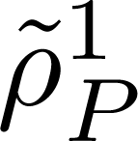
Correct definition of work in autonomous quantized machines
Work capacity:
What determines work capacity?

Slide 15
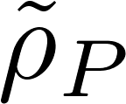
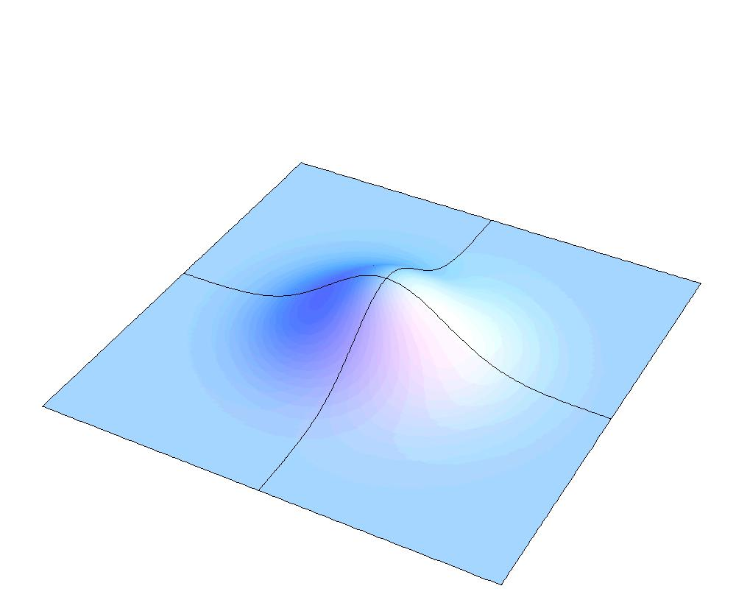
Work capacity is determined by accessible passive state
U
Passive states have monotonic energy distribution
U
Lenard, J. Stat. Phys. 19, 575 (1978).
W. Pusz, S.L. Woronowicz, Comm. Math. Phys. 58, 273 (1978).
Notes:
Pure state has work.
A Passive state is …..
And looks like this in the fock state and p representation
Gibbs is an special example (minimize energy)
??? Should I put an squezed state?

Slide 16
Work capacity evolution (piston charging)
The engine is a charger and the piston state is a battery
How to evaluate?
D. Gelbwaser-Klimovsky, R. Alicki, G. Kurizki EPL 103 60005 (2013)

Slide 17
Work capacity evolution by non-passivity definition
EPL 103, 60005 (2013)
Min. energy (same entropy)
Effective temperature
Correct work-rate (power):
standard
Enforced by QM

Slide 18
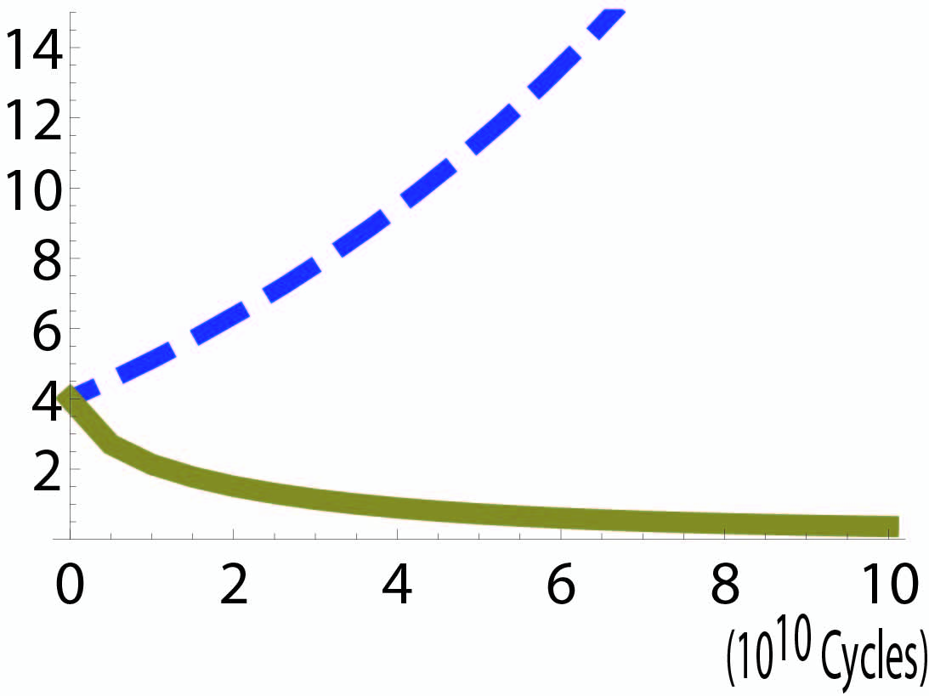
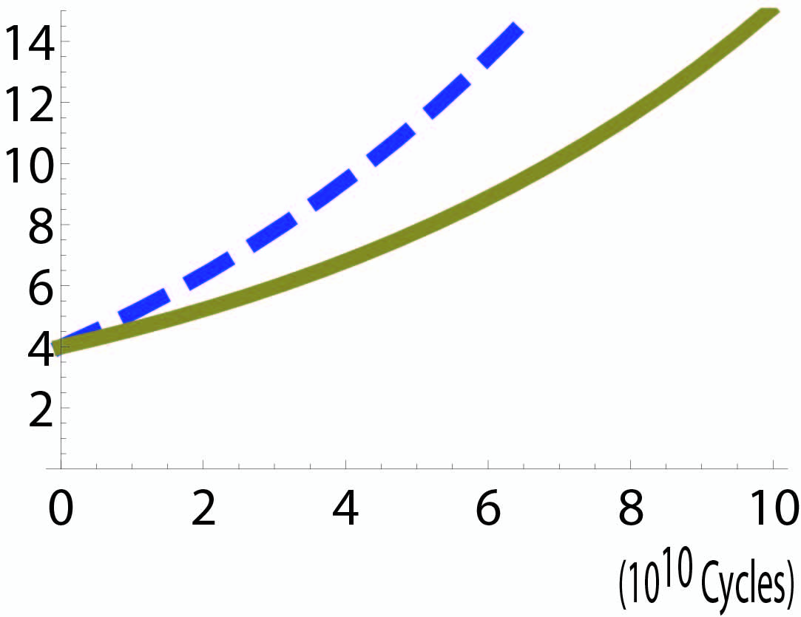
Autonomous QHE: Only nonpassive P yields work.
EPL 103 60005 (2013)
Linear amplifier
Fock
Coherent
Quickly becomes passive
Remains nonpassive

Slide 19
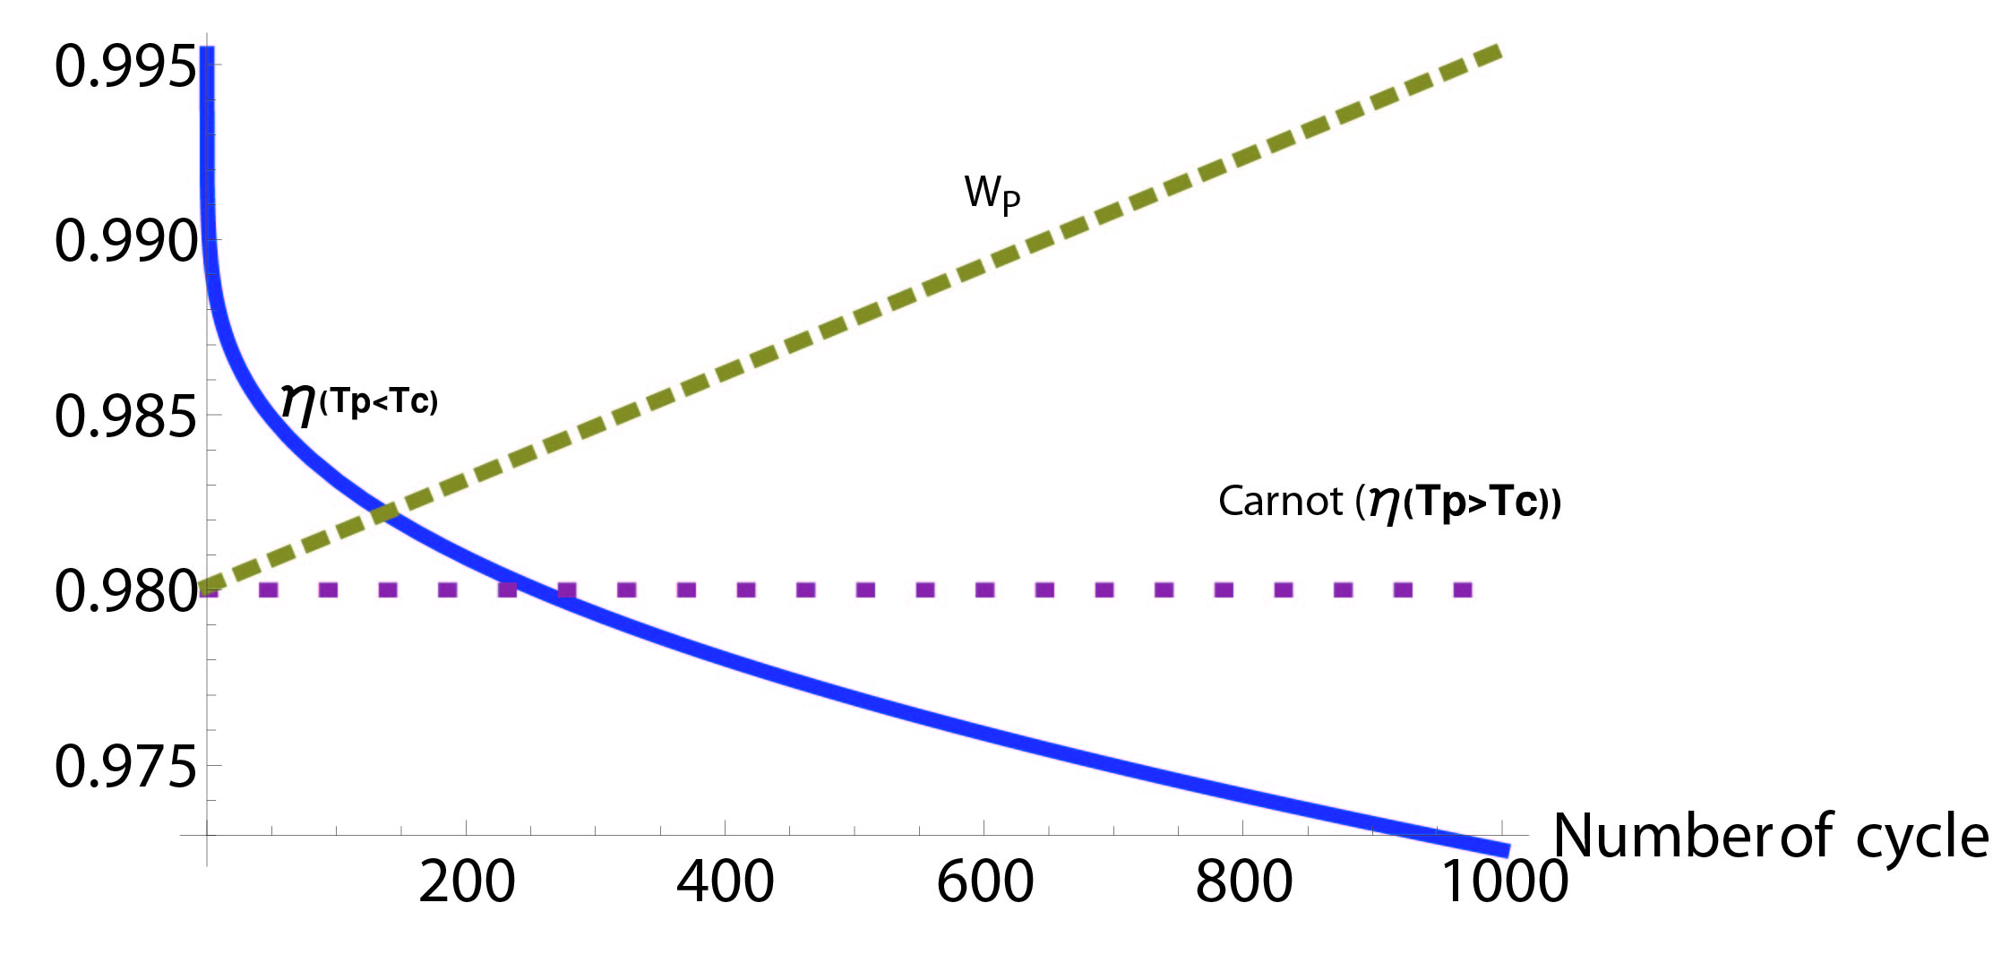
Efficiency-bound evolution of linear-amplifier autonomous QHE
D. Gelbwaser and GK
Under Spohn’s second-law constraint :
s

Slide 20
Efficiency-bound evolution of quantized refrigerator
D. Gelbwaser & G. K
Engine-refrigerator reciprocity broken!
What’s “bad” for work (fragility, thermalization) is “good” for cooling

Slide 21
Revisit 4-stroke cycle efficiency
S
D
C
A
B
Working fluid P distribution
w
Notes:
Sup otto cycle, you can chose anything
There are Strokes (I chose something random)
Some interact with bath and some not
With the bath all the energy exchange is heat and in the other depend the cycle (BIG SUPOSITION)
The working fluid is always in passive state!!!
Enfasis notacion

Slide 22
Non-passivity for non-thermal 4-stroke cycle D. Gelbwaser and GK
Above carnot?
Non passive
D
C
?
A
B
Non thermal process (squeezing)
Notes:
What if doing one of the strokes we have a non thermal bath or other processs
Then after the stroke the phase may reach a non passive state and has work capacity
In principle it may be extracted
But then arrive in contact with cold bath in non passive state and it is losted
This work should be substracted in the final count

Slide 23
C
D
?
A
B
Non thermal
Carnot
Notes:
What if we do this…

Slide 24
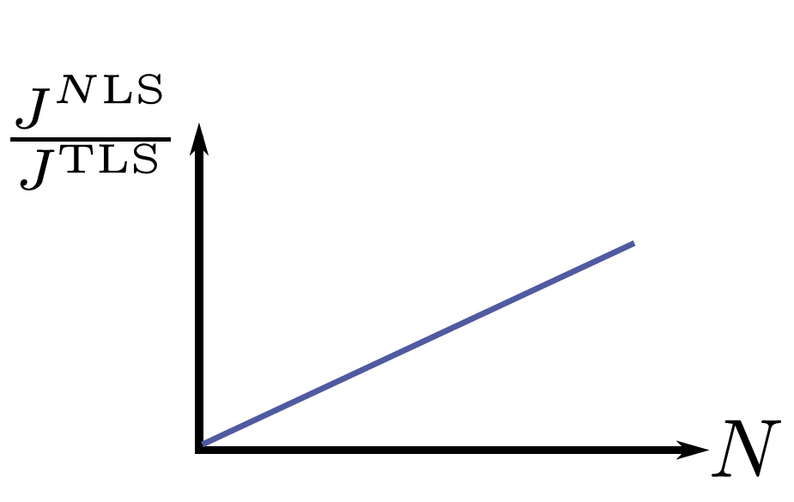
QHE power enhancement by degenerate-state correlations in 3-level systems
D. Gelbwaser-Klimovsky, W. Niedenzu, P. Brumer & GK
e
1
2
g
3
P
P
P
Scully et al.
(2003,2010,2011)

Slide 25
Two regimes: incomplete & complete thermalization
Aligned dipolar incomplete thermalization
Non-aligned dipolar complete thermalization

Slide 26
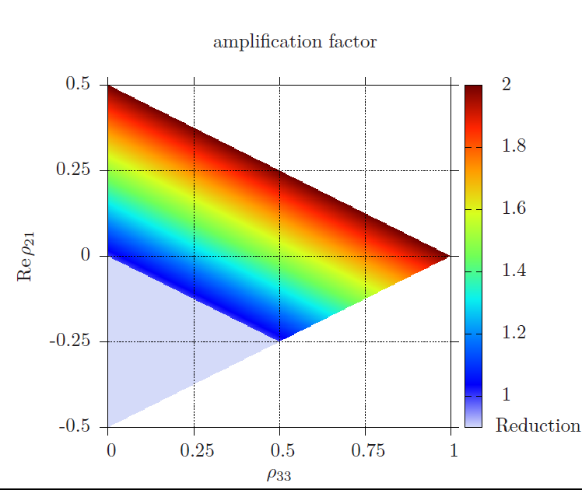
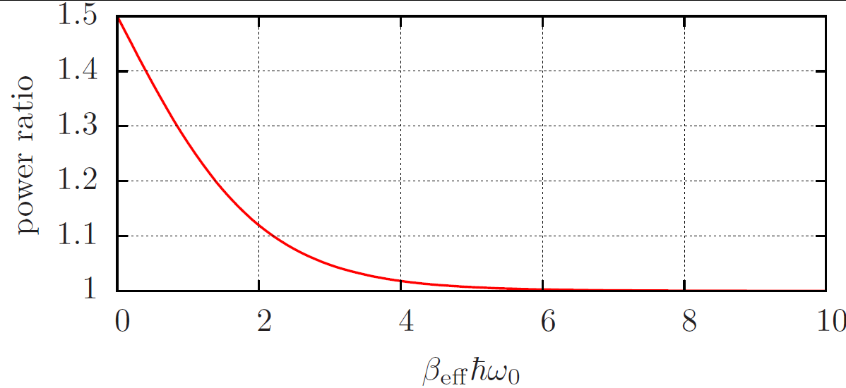
Power ratio: Aligned vs. misaligned dipoles
High temp
Low temp

Slide 27
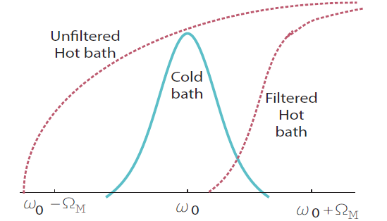
d) Optomechanical solar-pumped QHE
(with S.Rosenblum & B. Dayan,WIS)
Cold bath
Cavity (System)+Mechanical
Hot bath
S
BH
P

Slide 28
CONCLUSIONS I
Thermodynamic limits on quantum processes?
Fundamental implications
Does thermodynamics hold
at the quantum level?
Technological implications
-Cooling processes limits
-Quantum engine efficiency
Classical thermodynamics limits these processes….
… but quantum mechanical resources may help!
One should be careful when defining heat and work.
Use passivity
Work
Notes:
Que mas?
Nonthermal baths may exchange also work?

Slide 29
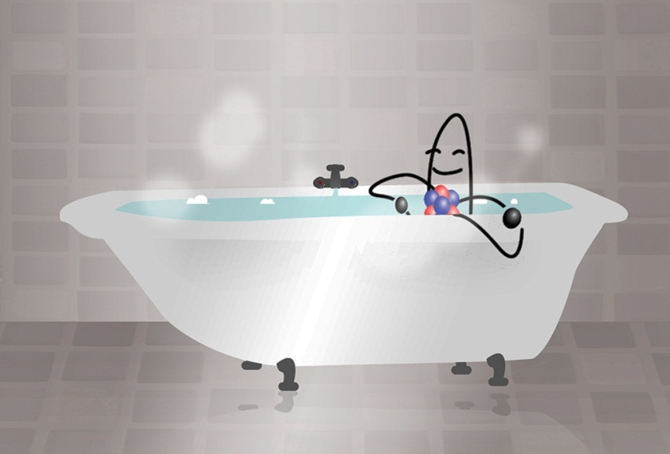
Conclusions II
minimal (single-qubit) machines (for separated bath spectra):
a) quantum refrigerator (QR) may defy the third law
b) quantum heat machines may temporarily defy the Carnot limit but still adhere to the second law
QHE: for weak coherent input
QR: for Fock/nonclassical input
c) Nonthermal reservoirs do not enhance efficiency.
d) Multilevel heat machines may enhance power output but not efficiency
Detailed-balance breakdown
Quantum devices may enjoy more flexible thermodynamic bounds, if resources are properly accounted for.

Slide 30
Notes:
Pensar chiste

Slide 31
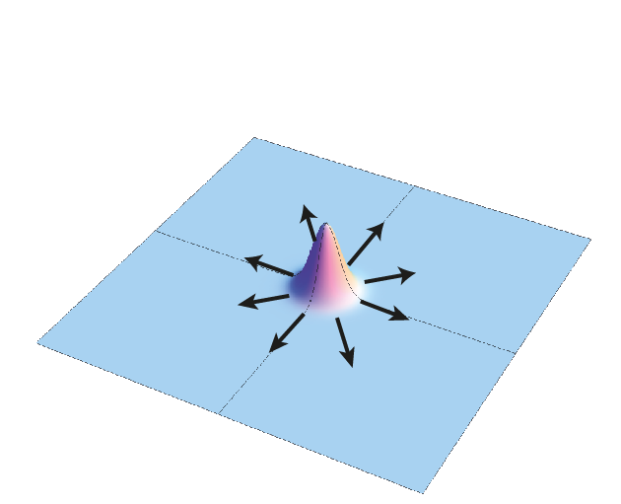
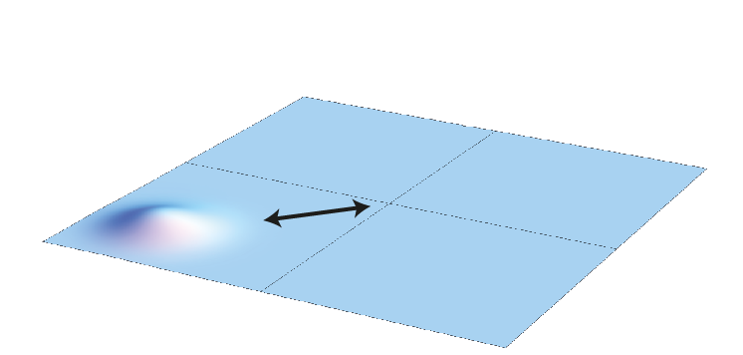
Quantum Piston/Battery
A Lindblad for system + piston/battery
Time-scale separation: system attains steady state very fast while piston/battery keeps evolving
Notes:
Dar sistema en una cavidad!

